Slide 1

Weather Dashboard
By Team React (Seema, Charlotte, Ahmed and Mohamed)

Slide 2

Elevator Pitch
To create a real-world front-end application that we can showcase to future employees. This weather dashboard is an interactive web-page that allows users to search location of choice and preview up to 5 days weather forecast. Features such as saving data and viewing location on map are just two of the many features included on this webpage using clean user interface and java-script.

Slide 3
Concept
*insert bits of readme to help complete this*
Charlotte

Slide 4
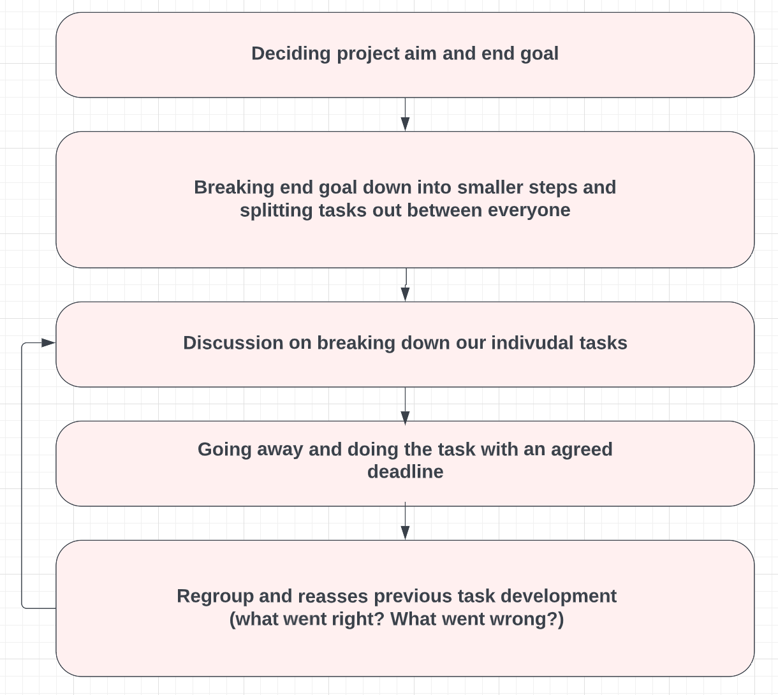
Process
Beginning with the end in mind
Understanding what the overall task involved
Notes:
Deciding the overall

Slide 5
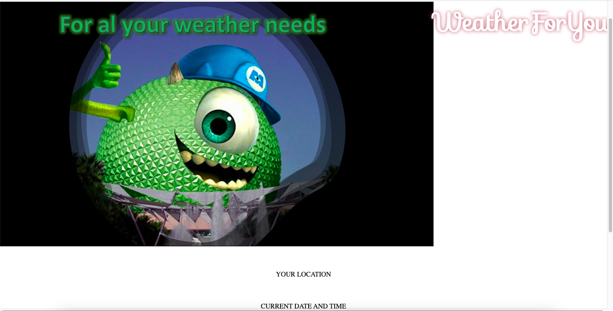
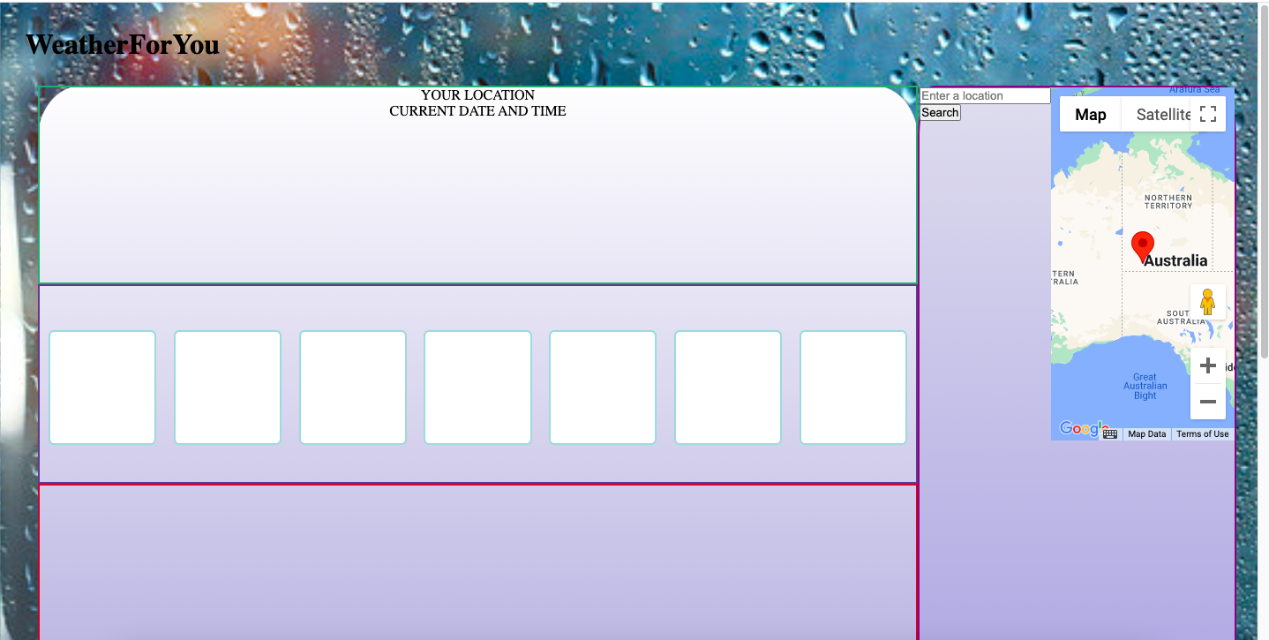
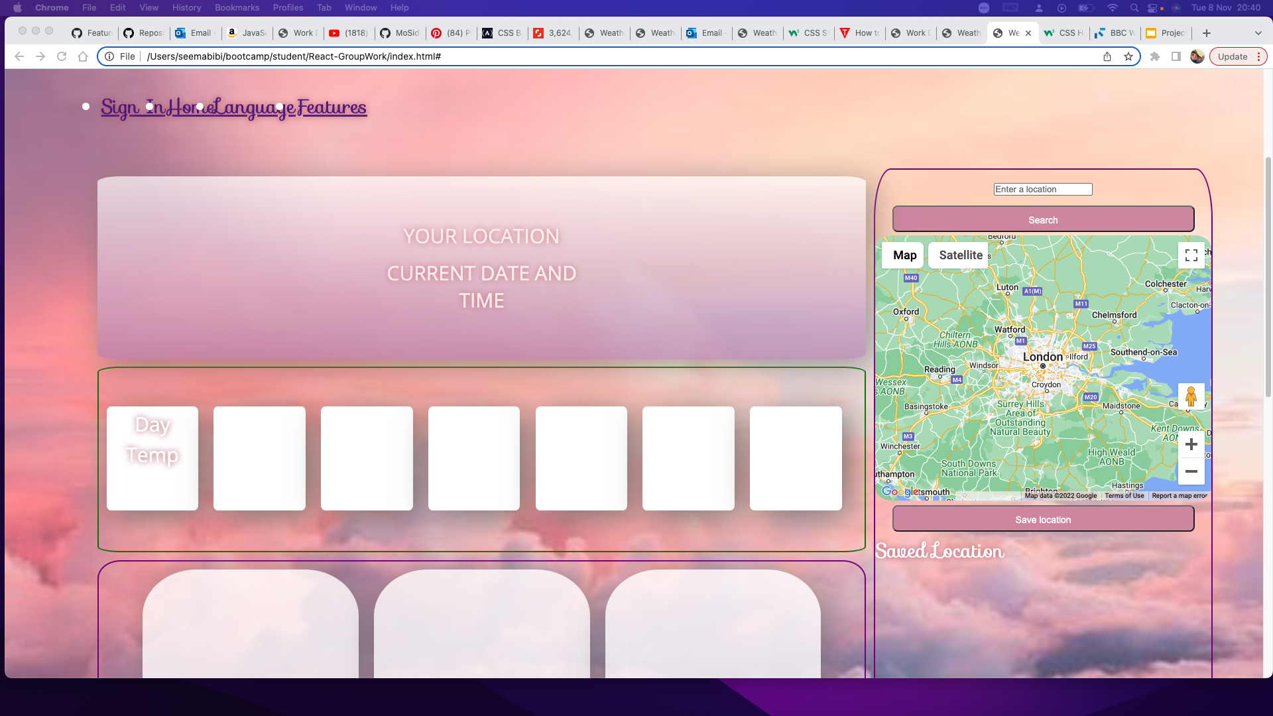
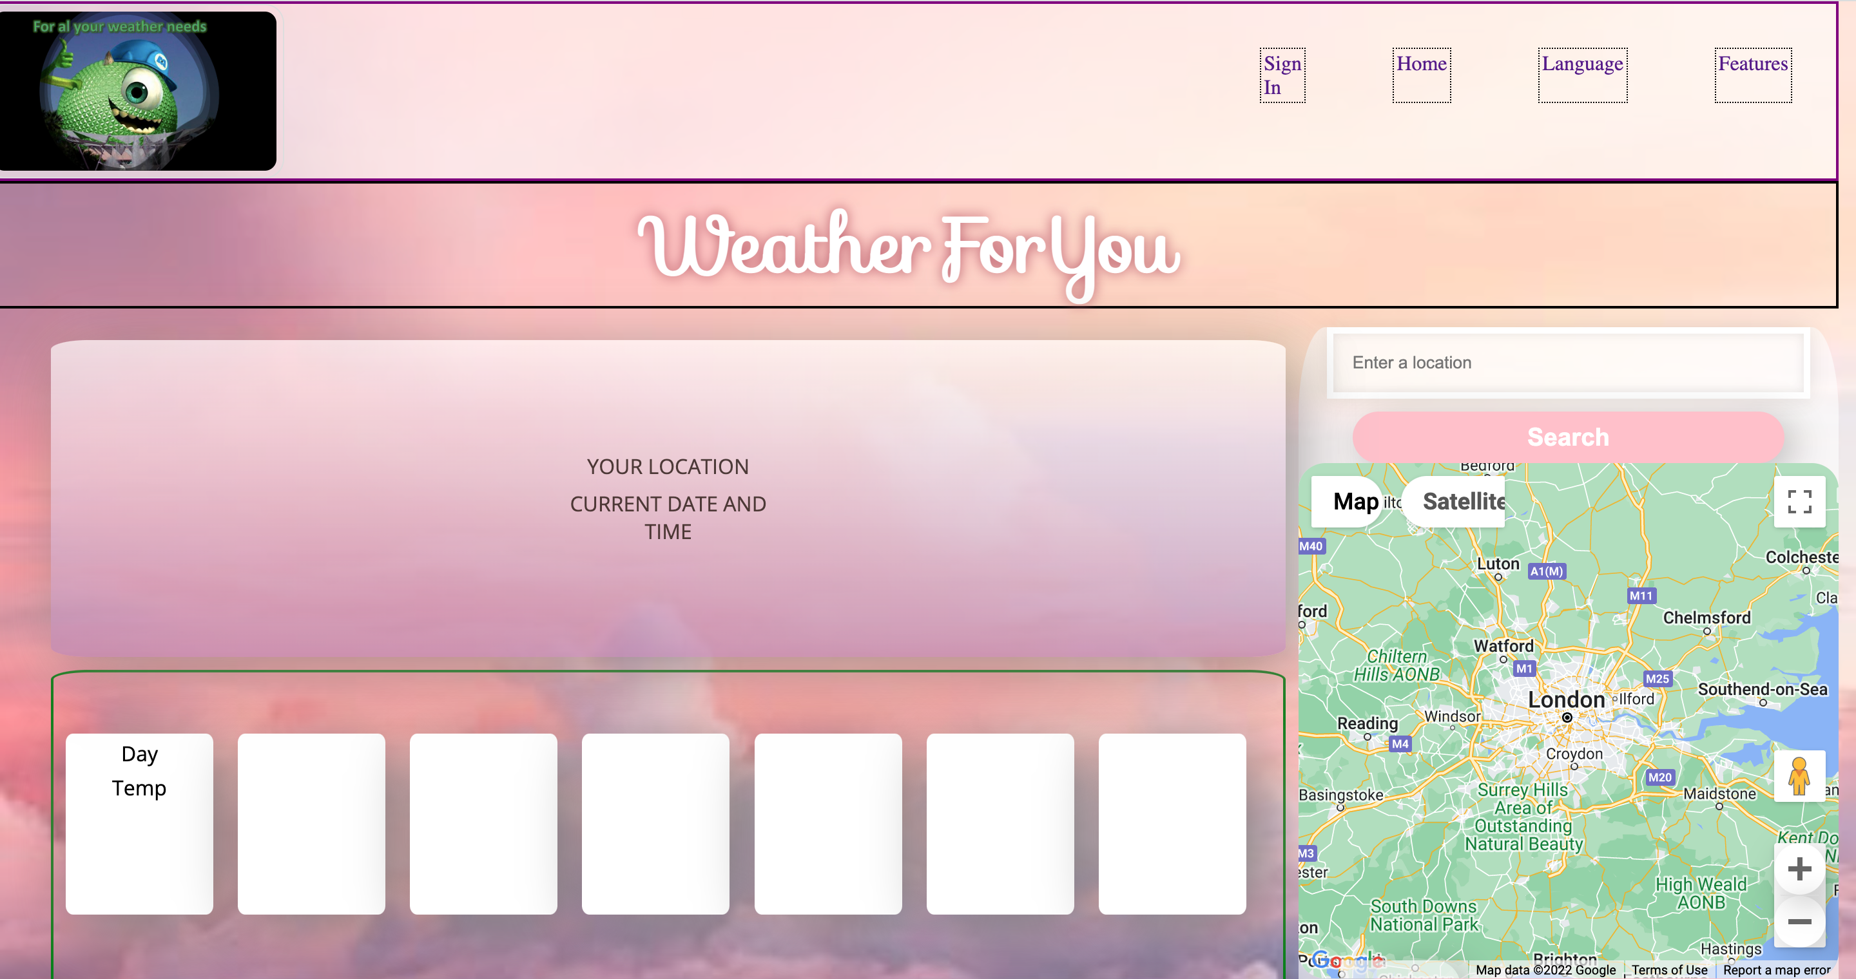
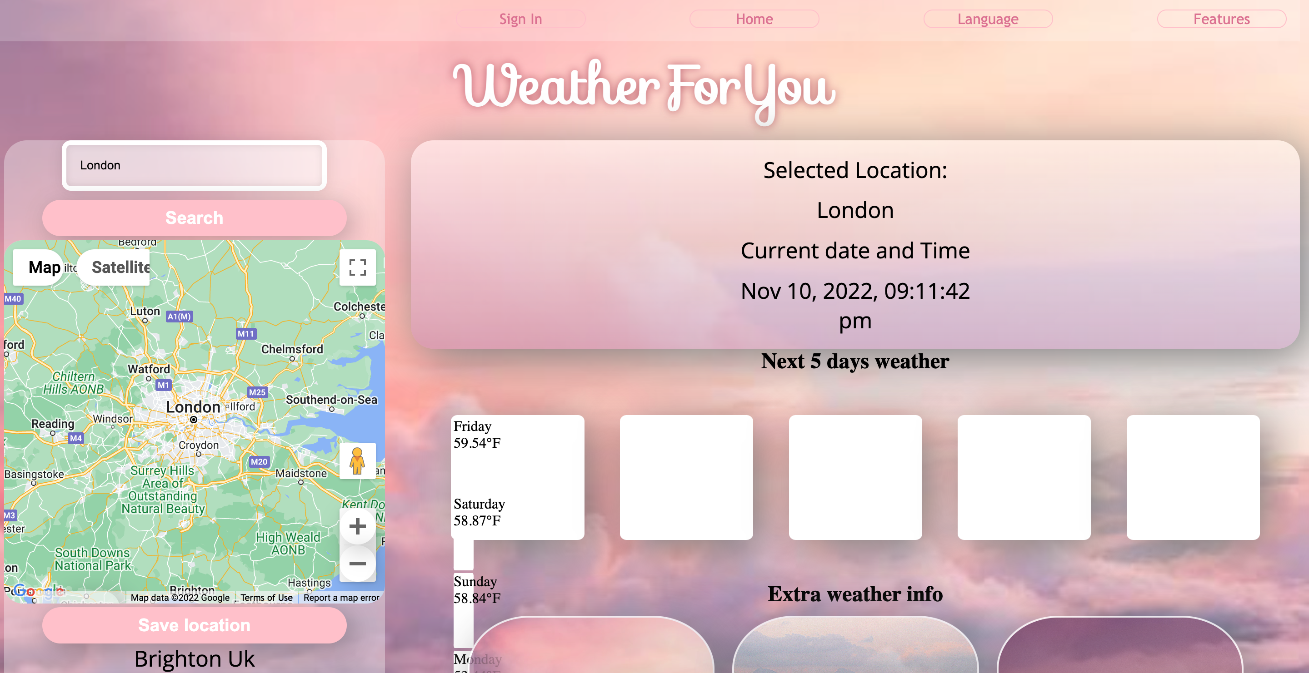
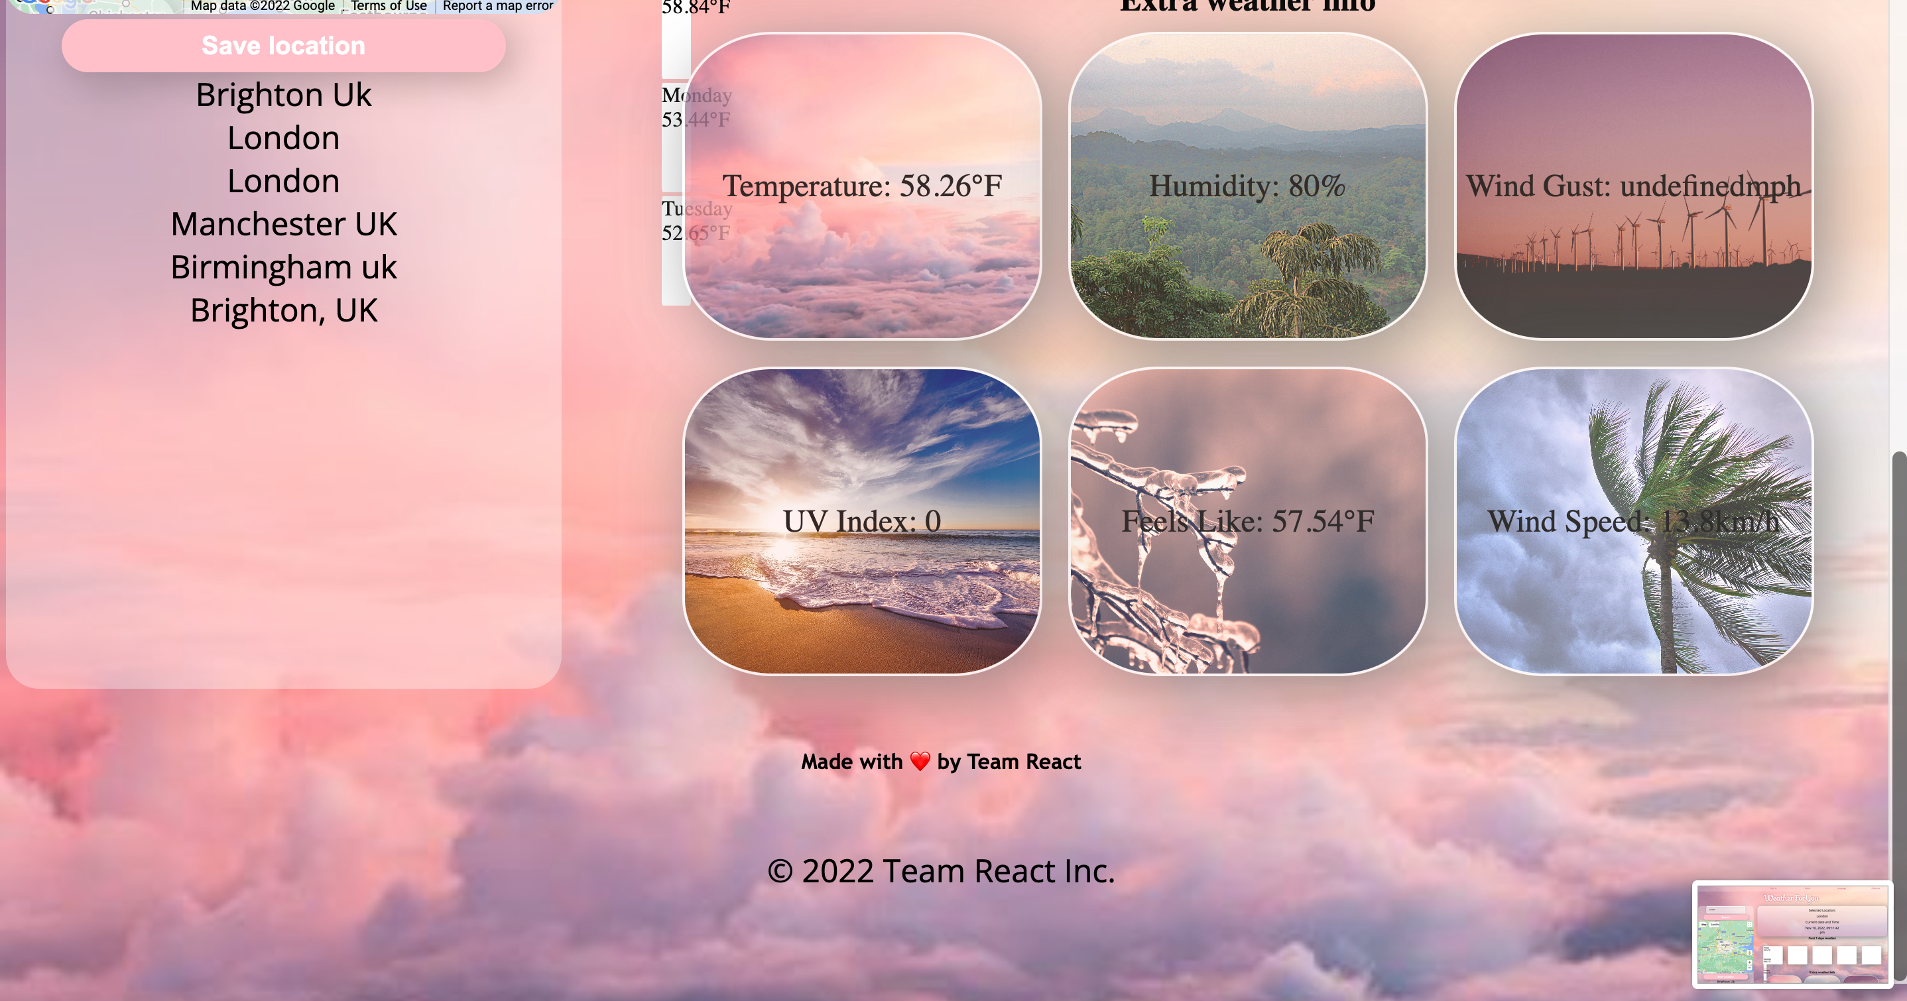
Behind the Scenes
Seema

Slide 6
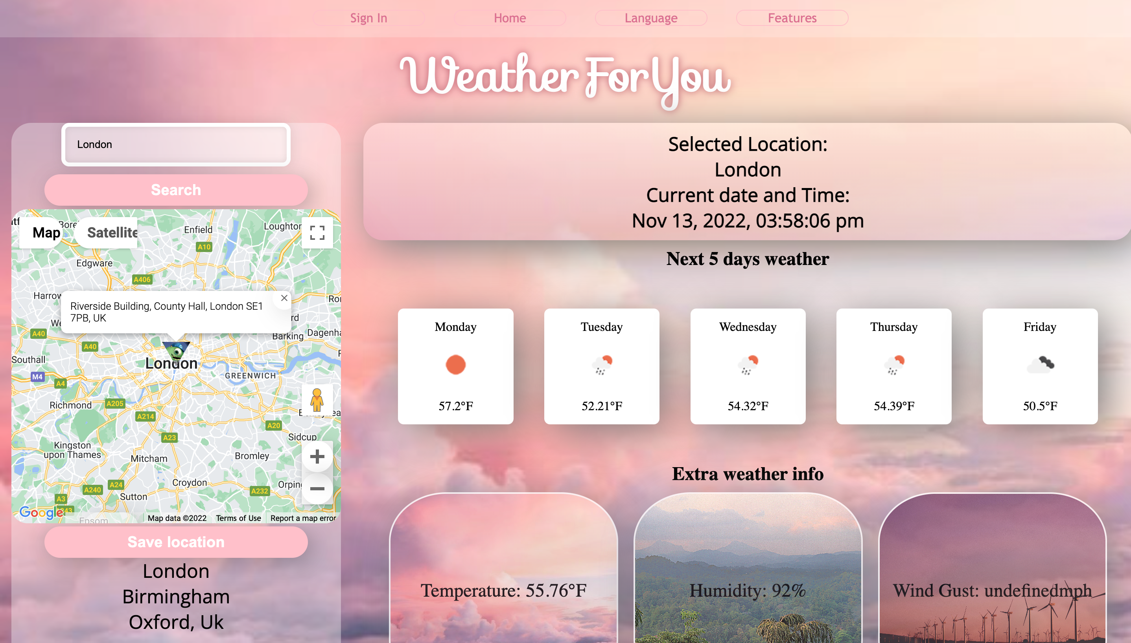
Demo
C

Slide 7
Personal enjoyment and struggles
Seema: I enjoyed working as a team and bringing different creative ideas together and really enjoyed the CSS elements of the project. I struggled understanding some of the JavaScript and the work behind the API’s and felt annoyed with merge conflicts.
Charlotte: I really enjoyed seeing my ideas come to life through the HTML and CSS. I would get caught up for long periods of time trying to fix small things rather than setting a time limit and asking others for help.
Ahmed: I Putting the skills I learned in using web APIs with JavaScript into a practical project. I struggled with Ensuring that the API's would function display the same results onto the screen as they did in the console.
Mohamed: I enjoyed Using JavaScript to implement website functionalities and handling of user input. I struggled wit ghetting the searched location from local storage so it is displayed after Page refresh, but I managed to get it working
Mohamed

Slide 8
Direction for Future Development
Seema: I enjoyed working as a team and bringing different creative ideas together and really enjoyed the CSS elements of the project. I struggled understanding some of the JavaScript and the work behind API’s and felt annoyed with merge conflicts.
Charlotte:
Ahmed: I Putting the skills I learned in using web APIs with JavaScript into a practical project. I struggled with Ensuring that the API's would function display the same results onto the screen as they did in the console.
Mohamed:
Mohamed

Slide 9
Links
Deployed Link:
https://mosidow.github.io/React-GroupWork/
Github Repo:
https://github.com/MoSidow/React-GroupWork
Ahmed

Slide 10

THANK YOU FOR LISTENING

